Slide 1
Topic- Telecom Churn Analysis

Slide 2
PROBLEM STATEMENT
Domain Topic Telecom Churn Analysis Telecom Churn (loss of customers to competition) is a problem for telecom companies because it is expensive to acquire a new customer and companies want to retain their existing customers. Most telecom companies suffer from voluntary churn.
Customer retention can be achieved with good customer service and products. But the most effective way for a company to prevent attrition of customers is to truly know them. The vast volumes of data collected about customers can be used to build churn prediction models. Knowing who is most likely to defect means that a company can priorities focused marketing efforts on that subset of their customer base.
I will examine customer data from Sample Data Sets with the aim of building and comparing several customer churn prediction models.

Slide 3
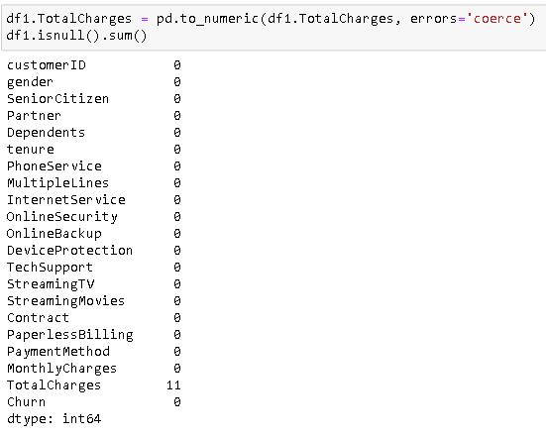

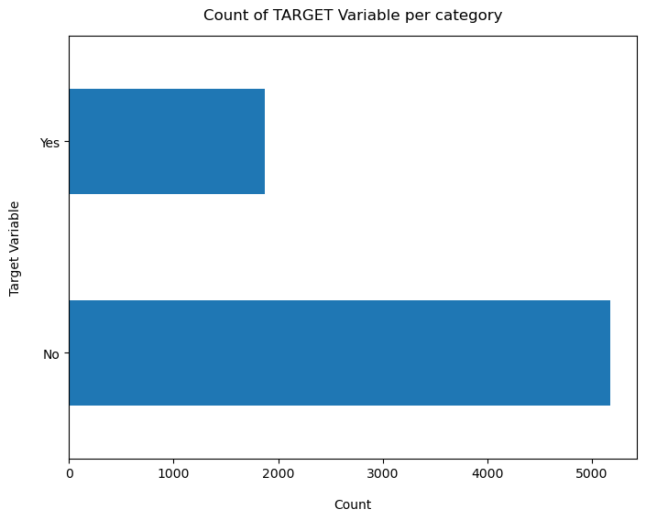
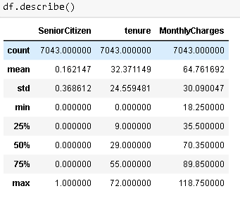
DATA CLEANING
SeniorCitizen is actually a categorical hence the 25%-50%-75% distribution is not proper

Slide 4
Data Exploration
Plot distribution of individual predictors by churn

Slide 5
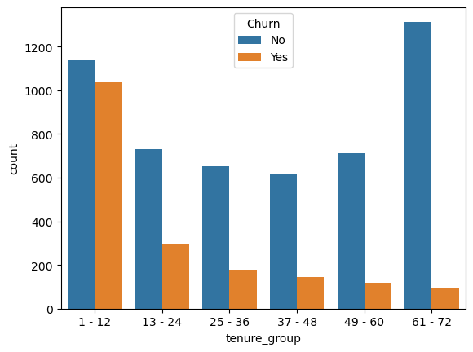
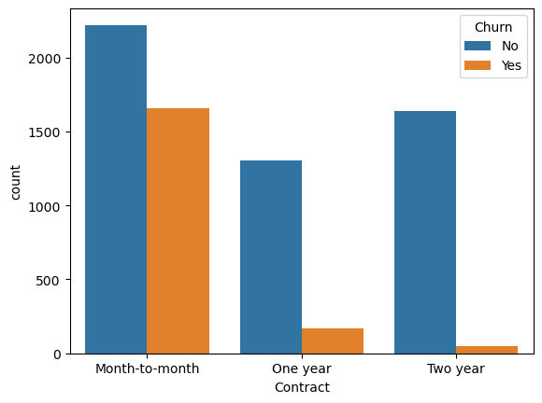
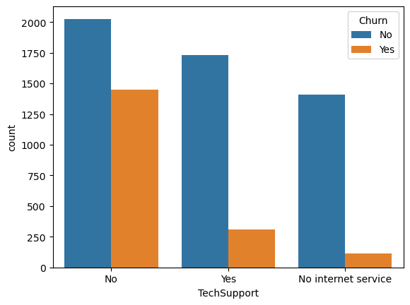
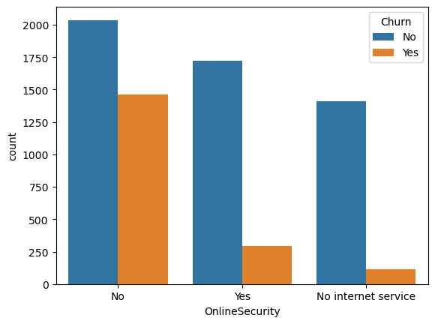
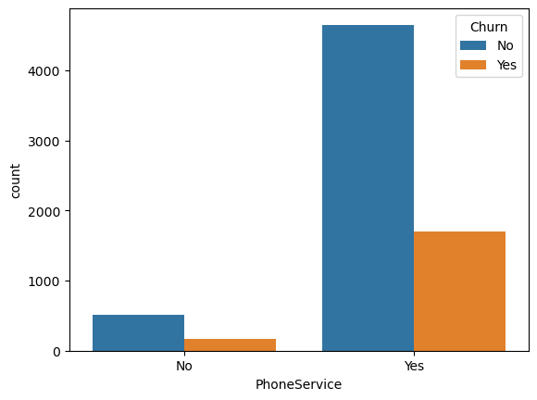
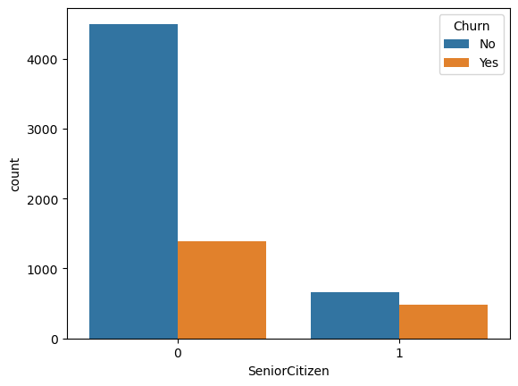
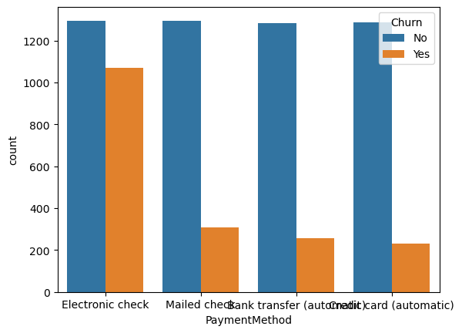
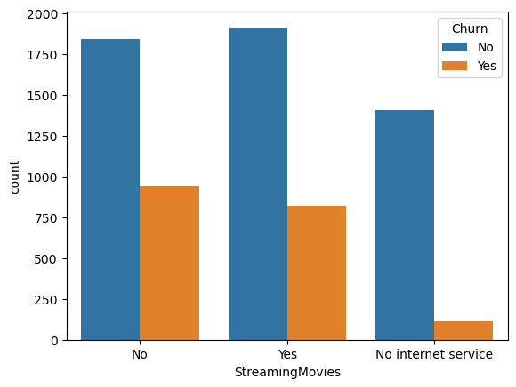
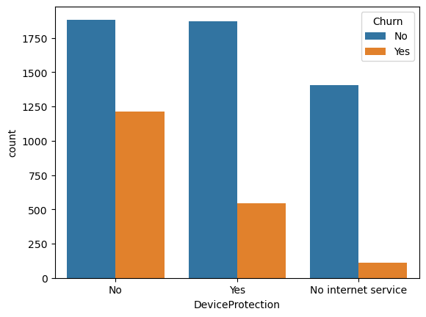
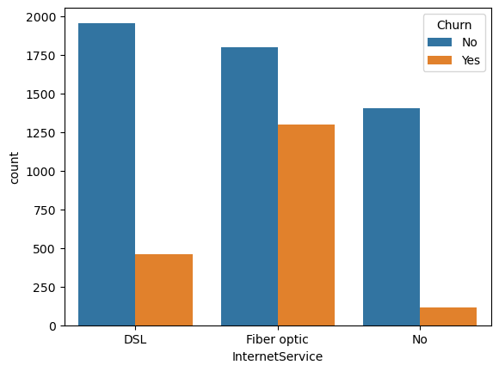
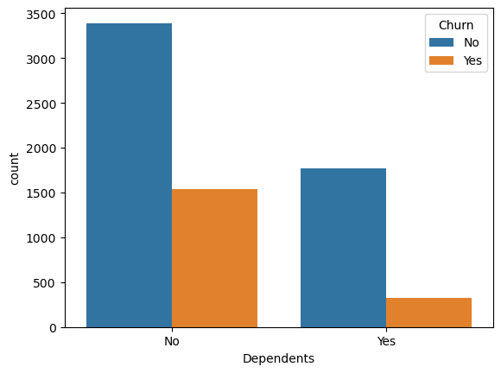
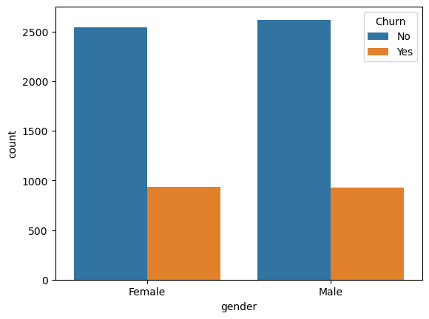
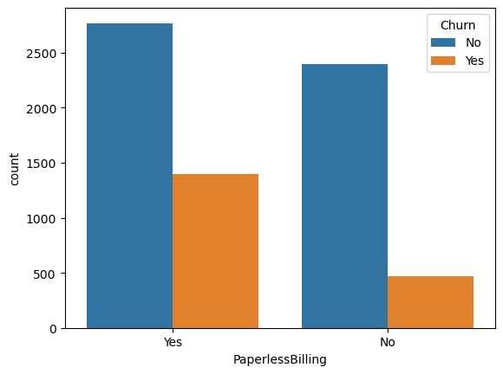
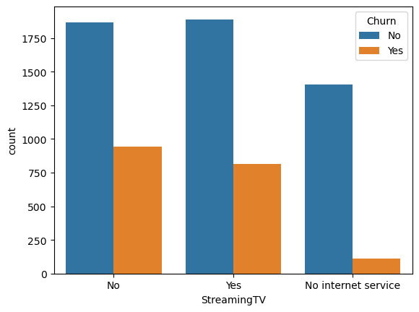
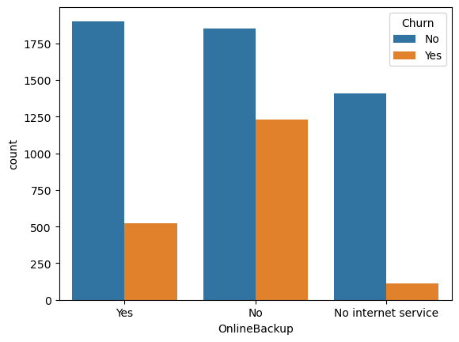
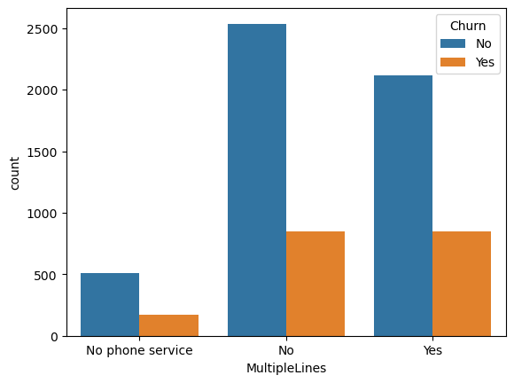
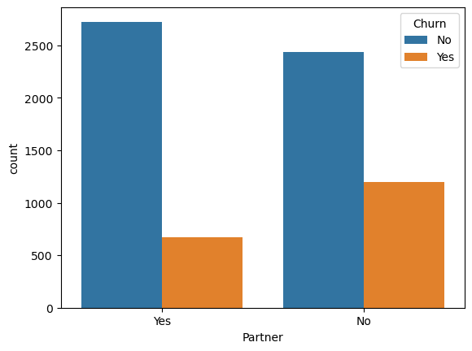
Univariate Analysis

Slide 6
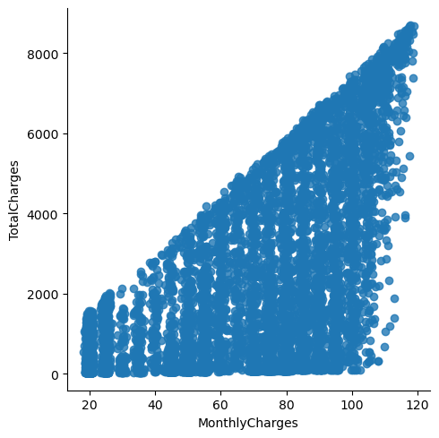
Relationship between Monthly Charges and Total Charges
Total Charges increase as Monthly Charges increase - as expected.

Slide 7
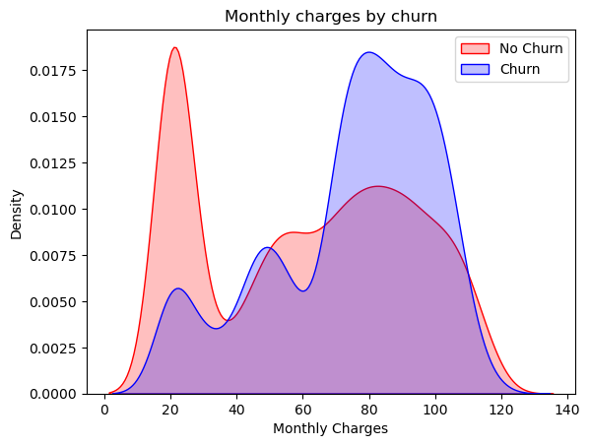
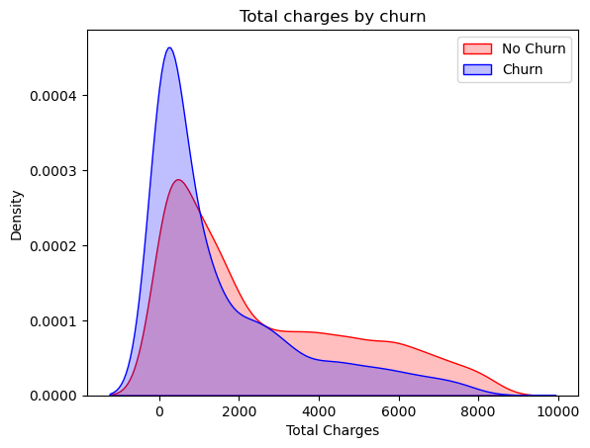
Churn by Monthly Charges and Total Charges
Churn is high when Monthly Charges are high
as higher Churn at lower Total Charges
Higher Monthly Charge, Lower tenure and Lower Total Charge are linked to High Churn.
As higher Churn at lower Total Charges
Higher Monthly Charge, Lower tenure and Lower Total Charge are linked to High Churn

Slide 8
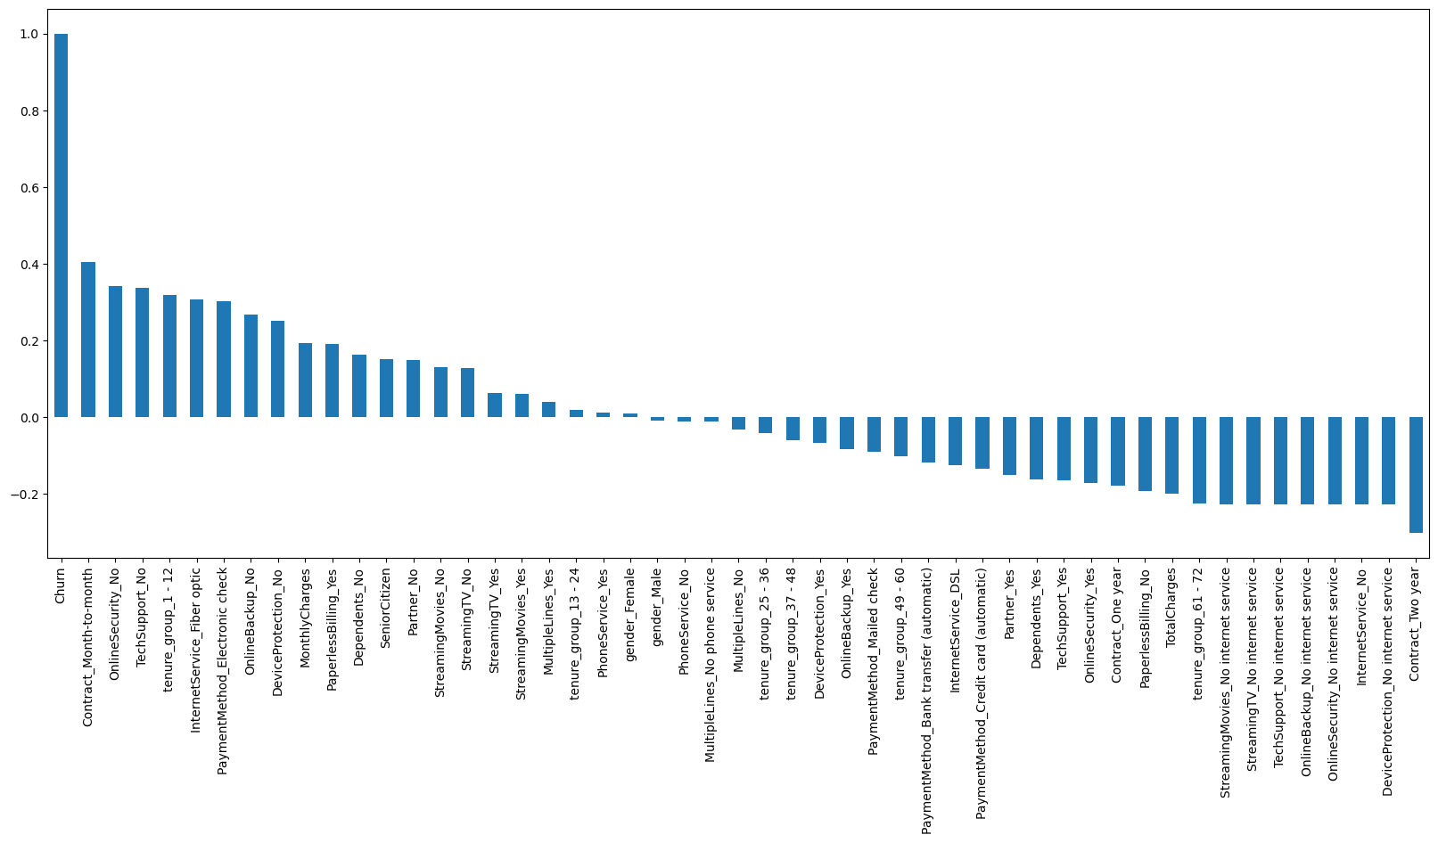
The resulting bar chart will show which columns in the DataFrame have the strongest positive correlation with the 'Churn' column at the top and the strongest negative correlation at the bottom. This can help identify which features are most influential in determining whether a customer churns or not.
HIGH Churn - Month to month contracts, No online security, No Tech support,First year of subscription and Fibre Optics Internet
LOW Churn -Long term contracts**, Subscriptions without internet service and The customers engaged for 5+ years
Features like Gender, Availability of PhoneService and multiple lines have almost NO impact on Churn

Slide 9
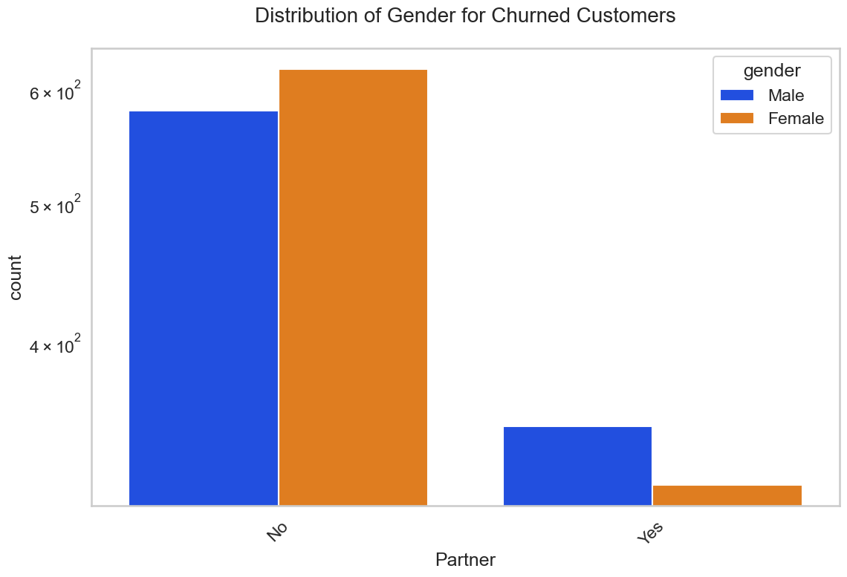
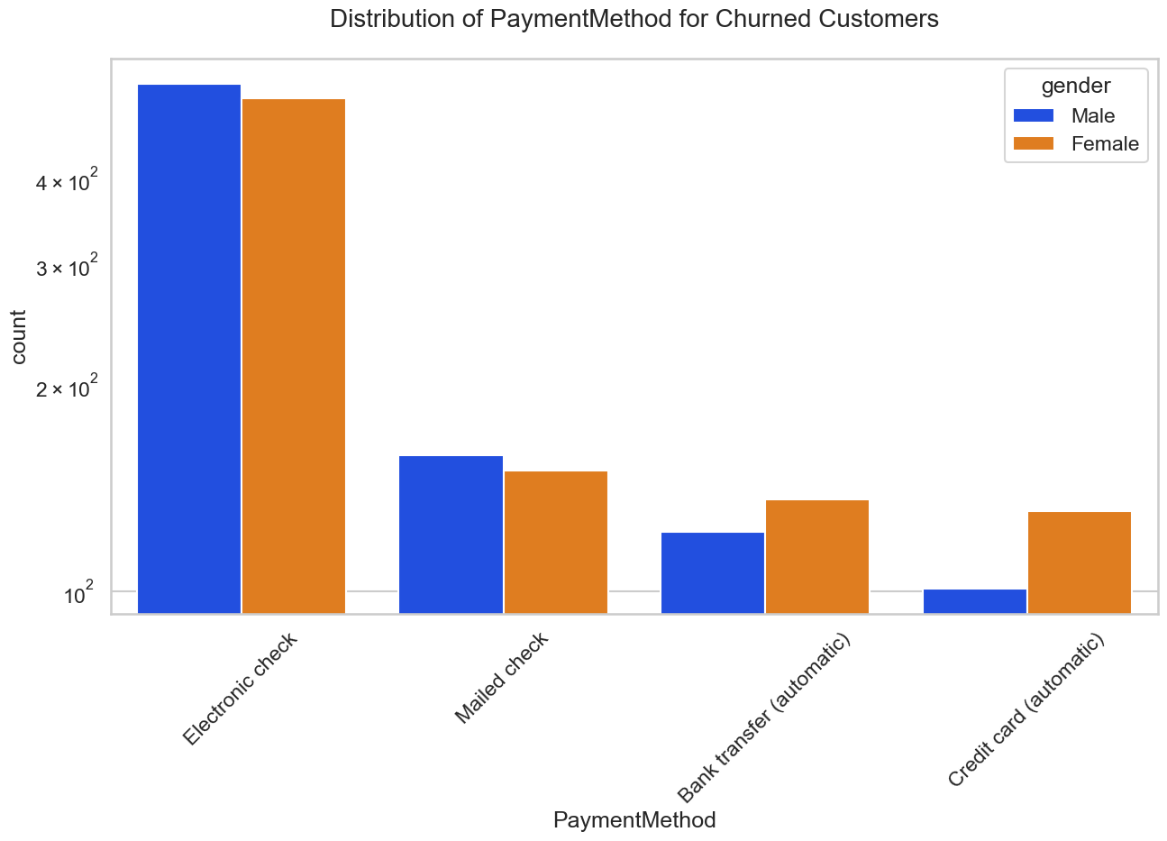
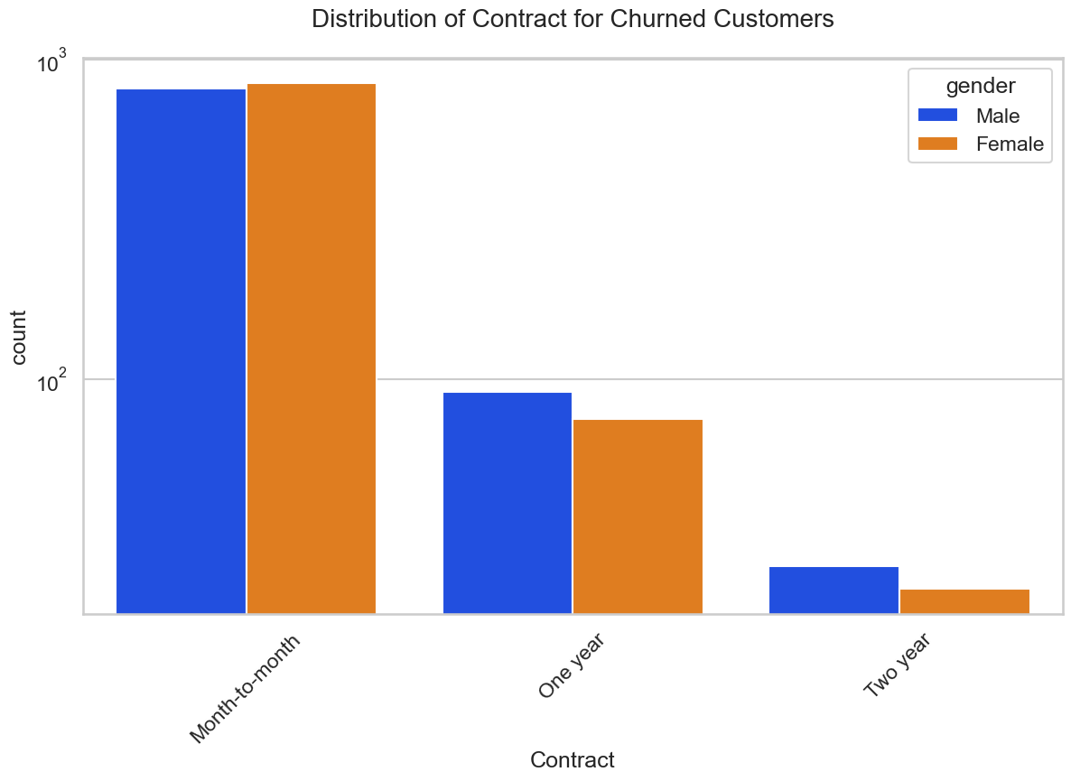
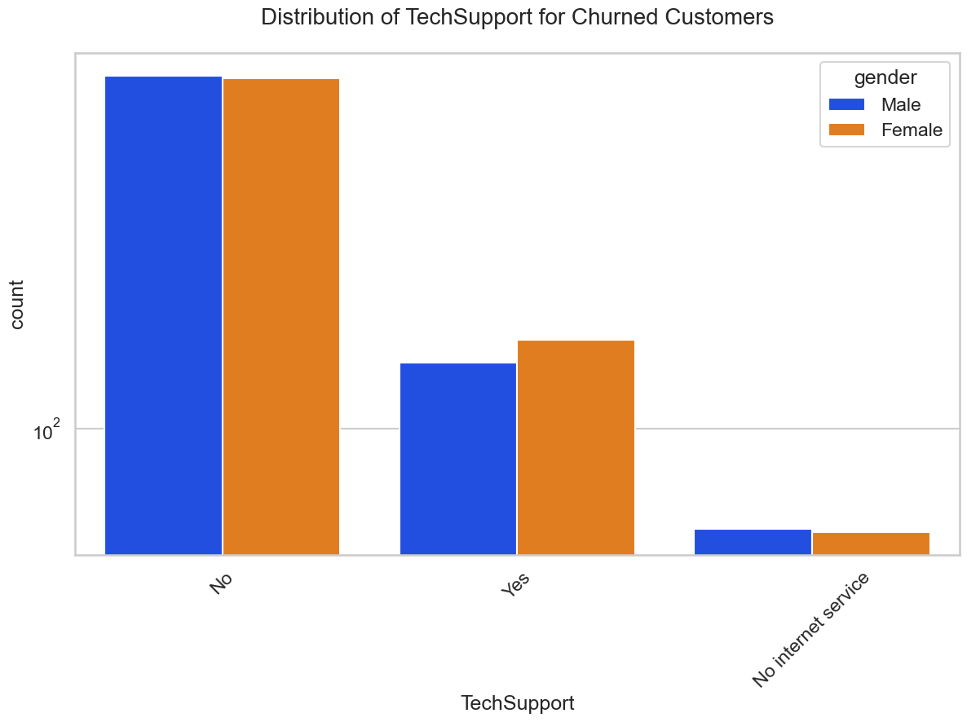
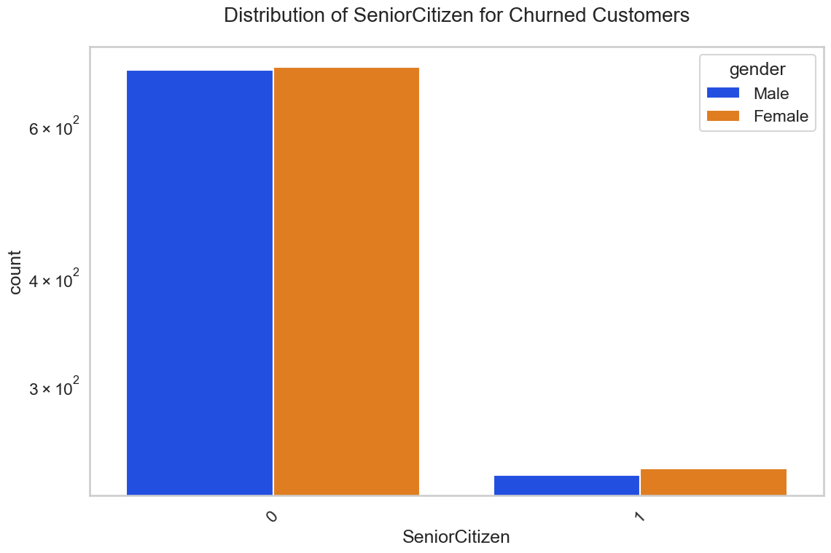
Bivariate Analysis

Slide 10
We will build a model using the insights we get from this data which we are going to store in another excel i.e churn 1. PaymentMethod -Electronic check 2. Contract Type -monthly. 3. OnlineSecurity -No Online security, 4. TechSupport -No Tech Support 5. SeniorCitizen -Non senior Citizens Above are the categories who have highest churners

Slide 11
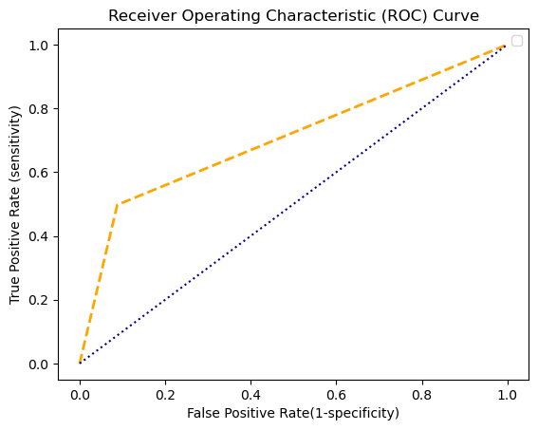
Logistic Regression
Confusion Matrix:
[[955 92]
[181 179]]
Accuracy: [0.80597015]
Sensitivity : [0.84066901]
Specificity : [0.66051661]
Precision: [0.91212989]
Recall: [0.84066901]
F-score: [0.87494274]
AUC: 0.7046760585800701
ROC curve:

Slide 12
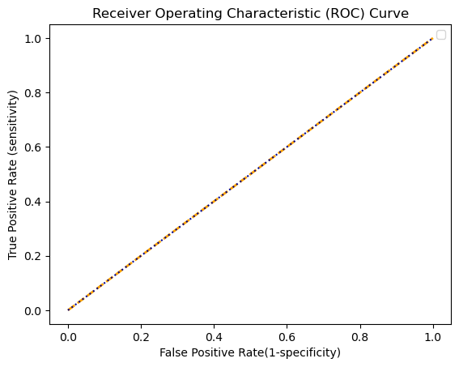
Support Vector Machine
Confusion Matrix:
[[1047 0]
[ 360 0]]
Accuracy: [0.74413646]
Sensitivity : [0.74413646]
Specificity : [nan]
Precision: [1.]
Recall: [0.74413646]
F-score: [0.85330073]
AUC: 0.5
ROC curve

Slide 13
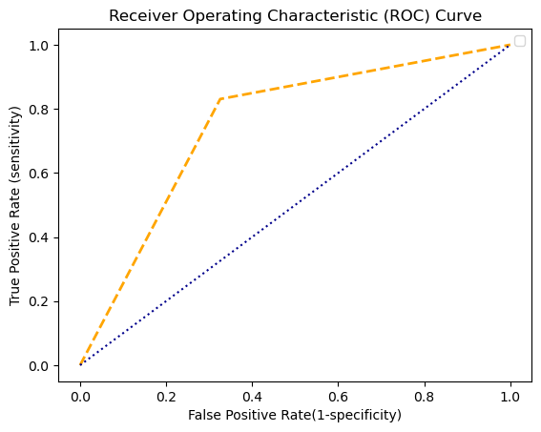
Naive bayes Classification
Confusion Matrix:
[[706 341]
[ 61 299]]
Accuracy: [0.71428571]
Sensitivity : [0.92046936]
Specificity : [0.4671875]
Precision: [0.67430755]
Recall: [0.92046936]
F-score: [0.7783903]
AUC: 0.7524315504616366
ROC curve

Slide 14
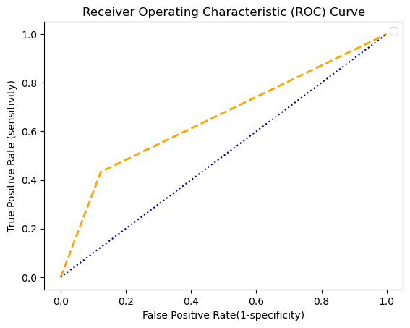
K - Nearest Neighbour
Confusion Matrix:
[[918 129]
[204 156]]
Accuracy: [0.76332623]
Sensitivity : [0.81818182]
Specificity : [0.54736842]
Precision: [0.87679083]
Recall: [0.81818182]
F-score: [0.84647303]
AUC: 0.6550620821394461
ROC curve:

Slide 15
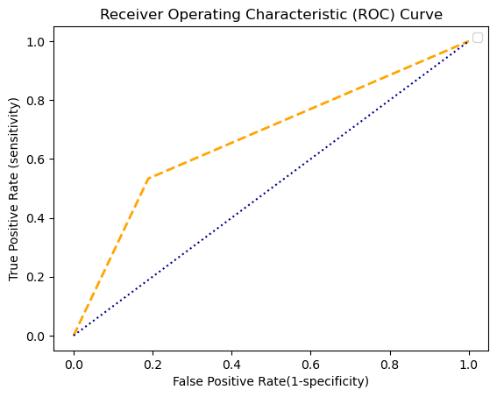
Decision Tree
Confusion Matrix:
[[849 198]
[168 192]]
Accuracy: [0.73987207]
Sensitivity : [0.83480826]
Specificity : [0.49230769]
Precision: [0.81088825]
Recall: [0.83480826]
F-score: [0.82267442]
AUC: 0.6721107927411651
ROC curve:

Slide 16

Random Forest
Confusion Matrix:
[[937 110]
[192 168]]
Accuracy: [0.78535892]
Sensitivity : [0.829938]
Specificity : [0.60431655]
Precision: [0.89493792]
Recall: [0.829938]
F-score: [0.86121324]
AUC: 0.6808022922636104
ROC curve:

Slide 17
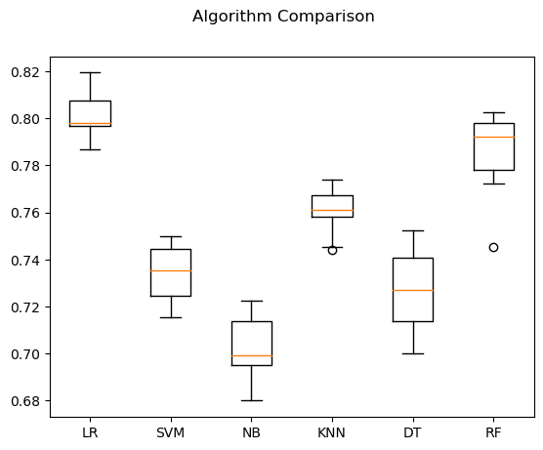
Algorithm Comparison
LR: 0.801479 (0.009105)
SVM: 0.734215 (0.012067)
NB: 0.702075 (0.012983)
KNN: 0.760665 (0.009373)
DT: 0.726676 (0.016606)
RF: 0.786401 (0.016820)
It provides a list of each algorithm short name, the mean accuracy and the standard deviation accuracy and also provides a box and whisker plot showing the spread ofthe accuracy scores across each cross validation fold for each algorithm

Slide 18
Conclusion
With LR Classifier, also we are able to get quite good results, in fact better than Decision Tree so we will proceed with LR classifier

Slide 19
THANK YOU

